Slide 1
Anaphora Resolution
Spring 2010, UCSC – Adrian Brasoveanu
[Slides based on various sources, collected over a couple of years and repeatedly modified – the work required to track them down & list them would take too much time at this point. Please email me (abrsvn@gmail.com) if you can identify particular sources.]

Slide 2
Introduction
Language consists of collocated, related groups of sentences. We refer to such a group of sentences as a discourse.
There are two basic forms of discourse:
  Monologue;
  Dialogue;
We will focus on techniques commonly applied to the interpretation of monologues.

Slide 3
Reference Resolution
Reference: the process by which speakers use expressions to denote an entity.
Referring expression: expression used to perform reference .
Referent: the entity that is referred to.
Coreference: referring expressions that are used to refer to the same entity.
Anaphora: reference to a previously introduced entity.

Slide 4
Reference Resolution
Discourse Model
It contains representations of the entities that have been referred to in the discourse and the relationships in which they participate.
Two components required by a system to produce and interpret referring expressions.
  A method for constructing a discourse model that evolves dynamically.
  A method for mapping between referring expressions and referents.

Slide 5
Reference Phenomena
Five common types of referring expression
Type | Example
Indefinite noun phrase | I saw a Ford Escort today.
Definite noun phrase | I saw a Ford Escort today. The Escort was white.
Pronoun | I saw a Ford Escort today. It was white.
Demonstratives | I like this better than that.
One-anaphora | I saw 6 Ford Escort today. Now I want one.
Three types of referring expression that complicate the reference resolution
Type | Example
Inferrables | I almost bought a Ford Escort, but a door had a dent.
Discontinuous Sets | John and Mary love their Escorts. They often drive them.
Generics | I saw 6 Ford Escorts today. They are the coolest cars.

Slide 6
Reference Resolution
How to develop successful algorithms for reference resolution? There are two necessary steps.
First is to filter the set of possible referents by certain hard-and-fast constraints.
Second is to set the preference for possible referents.

Slide 7
Constraints (for English)
Number Agreement:
  To distinguish between singular and plural references.
    *John has a new car. They are red.
Gender Agreement:
  To distinguish male, female, and non-personal genders.
    John has a new car. It is attractive. [It = the new car]
Person and Case Agreement:
  To distinguish between three forms of person;
    *You and I have Escorts. They love them.
  To distinguish between subject position, object position, and genitive position.

Slide 8
Constraints (for English)
Syntactic Constraints:
  Syntactic relationships between a referring expression and a possible antecedent noun phrase
    John bought himself a new car. [himself=John]
    John bought him a new car. [him≠John]
Selectional Restrictions:
  A verb places restrictions on its arguments.
    John parked his Acura in the garage. He had driven it around for hours. [it=Acura, it≠garage];
    I picked up the book and sat in a chair. It broke.

Slide 9
Syntax can’t be all there is
John hit Bill. He was severely injured.
Margaret Thatcher admires Hillary Clinton, and George W. Bush absolutely worships her.

Slide 10
Preferences in Pronoun Interpretation
Recency:
  Entities introduced recently are more salient than those introduced before.
    John has a Legend. Bill has an Escort. Mary likes to drive it.
Grammatical Role:
  Entities mentioned in subject position are more salient than those in object position.
    Bill went to the Acura dealership with John. He bought an Escort. [he=Bill]

Slide 11
Preferences in Pronoun Interpretation
Repeated Mention:
  Entities that have been focused on in the prior discourse are more salient.
  John needed a car to get to his new job.
  He decided that he wanted something sporty.
  Bill went to the Acura dealership with him.
  He bought an Integra. [he=John]

Slide 12
Preferences in Pronoun Interpretation
Parallelism (more generally – discourse structure):
  There are also strong preferences that appear to be induced by parallelism effects.
    Mary went with Sue to the cinema. Sally went with her to the mall. [ her = Sue]
    Jim surprised Paul and then Julie shocked him. (him = Paul)

Slide 13
Preferences in Pronoun Interpretation
Verb Semantics:
  Certain verbs appear to place a semantically-oriented emphasis on one of their argument positions.
    John telephoned Bill. He had lost the book in the mall. [He = John]
    John criticized Bill. He had lost the book in the mall. [He = Bill]
    David praised Hans because he … [he = Hans]
    David apologized to Hans because he… [he = David]

Slide 14
Preferences in Pronoun Interpretation
World knowledge in general:
  The city council denied the demonstrators a permit because they {feared|advocated} violence.
  The city council denied the demonstrators a permit because they {feared|advocated} violence.
  The city council denied the demonstrators a permit because they {feared|advocated} violence.

Slide 15
The Plan
Introduce and compare 3 algorithms for anaphora resolution:
Hobbs 1978
Lappin and Leass 1994
Centering Theory

Slide 16
Hobbs 1978
Hobbs, Jerry R., 1978, ``Resolving Pronoun References'', Lingua, Vol. 44, pp. 311-338.
  Also in Readings in Natural Language Processing, B. Grosz, K. Sparck-Jones, and B. Webber, editors, pp. 339-352, Morgan Kaufmann Publishers, Los Altos, California.

Slide 17
Hobbs 1978
Hobbs (1978) proposes an algorithm that searches parse trees (i.e., basic syntactic trees) for antecedents of a pronoun.
  starting at the NP node immediately dominating the pronoun
  in a specified search order
  looking for the first match of the correct gender and number
Idea: discourse and other preferences will be approximated by search order.

Slide 18
Hobbs’s point
… the naïve approach is quite good. Computationally speaking, it will be a long time before a semantically based algorithm is sophisticated enough to perform as well, and these results set a very high standard for any other approach to aim for.
Yet there is every reason to pursue a semantically based approach. The naïve algorithm does not work. Any one can think of examples where it fails. In these cases it not only fails; it gives no indication that it has failed and offers no help in finding the real antecedent. (p. 345)

Slide 19
Hobbs 1978
This simple algorithm has become a baseline: more complex algorithms should do better than this.
Hobbs distance: i^{th} candidate NP considered by the algorithm is at a Hobbs distance of i.

Slide 20
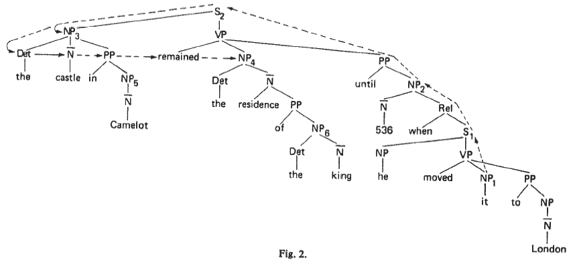
A parse tree
The castle in Camelot remained the residence of the king until 536 when he moved it to London.

Slide 21
Multiple parse trees
Because it assumes parse trees, such an algorithm is inevitably dependent on one’s theory of grammar.
1. Mr. Smith saw a driver in his truck.
2. Mr. Smith saw a driver of his truck.
“his” may refer to the driver in 1, but not 2.
different parse trees explain the difference:
  in 1, if the PP is attached to the VP, “his” can refer back to the driver;
  in 2, the PP is obligatorily attached inside the NP, so “his” cannot refer back to the driver.

Slide 22
Hobbs’s “Naïve” Algorithm
1. Begin at the NP immediately dominating the pronoun.
2. Go up tree to first NP or S encountered.
  Call node X, and path to it, p.
  Search left-to-right below X and to left of p, proposing any NP node which has an NP or S between it and X.
3. If X is highest S node in sentence,
  Search previous trees, in order of recency, left-to-right, breadth-first, proposing NPs encountered.
4. Otherwise, from X, go up to first NP or S node encountered,
  Call this X, and path to it p.
5. If X is an NP, and p does not pass through an N-bar that X immediately dominates, propose X.
6. Search below X, to left of p, left-to-right, breadth-first, proposing NP encountered.
7. If X is an S, search below X to right of p, left-to-right, breadth-first, but not going through any NP or S, proposing NP encountered.
8. Go to 2.

Slide 23
Add some hacks / heuristics
Add “simple” selectional restrictions, e.g.:
  dates can’t move
  places can’t move
  large fixed objects can’t move
For “they”, in addition to accepting plural NPs, collects selectionally compatible entities (somehow), e.g., conjoined NPs.
Assume some process that recovers elided constituents and inserts them in the tree.

Slide 24
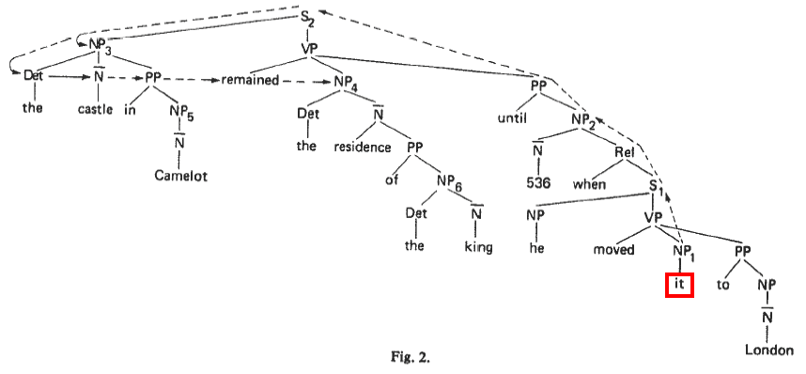
Example:
Let’s try to find the referent for “it”.

Slide 25
Hobbs’s “Naïve” Algorithm
1. Begin at the NP immediately dominating the pronoun.
2. Go up tree to first NP or S encountered.
  Call node X, and path to it, p.
  Search left-to-right below X and to left of p, proposing any NP node which has an NP or S between it and X.
3. If X is highest S node in sentence,
  Search previous trees, in order of recency, left-to-right, breadth-first, proposing NPs encountered.
4. Otherwise, from X, go up to first NP or S node encountered,
  Call this X, and path to it p.
5. If X is an NP, and p does not pass through an N-bar that X immediately dominates, propose X.
6. Search below X, to left of p, left-to-right, breadth-first, proposing NP encountered.
7. If X is an S, search below X to right of p, left-to-right, breadth-first, but not going through any NP or S, proposing NP encountered.
8. Go to 2.

Slide 26
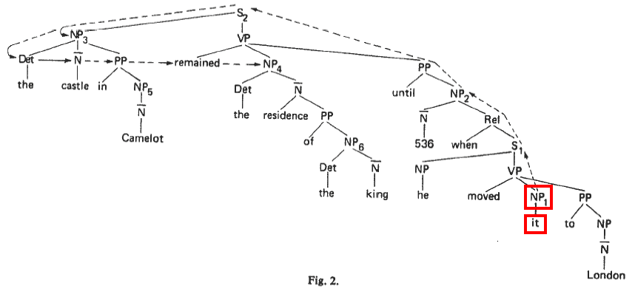
Example:
Begin at the NP immediately dominating the pronoun.

Slide 27
Hobbs’s “Naïve” Algorithm
1. Begin at the NP immediately dominating the pronoun.
2. Go up tree to first NP or S encountered.
  Call node X, and path to it, p.
  Search left-to-right below X and to left of p, proposing any NP node which has an NP or S between it and X.
3. If X is highest S node in sentence,
  Search previous trees, in order of recency, left-to-right, breadth-first, proposing NPs encountered.
4. Otherwise, from X, go up to first NP or S node encountered,
  Call this X, and path to it p.
5. If X is an NP, and p does not pass through an N-bar that X immediately dominates, propose X.
6. Search below X, to left of p, left-to-right, breadth-first, proposing NP encountered.
7. If X is an S, search below X to right of p, left-to-right, breadth-first, but not going through any NP or S, proposing NP encountered.
8. Go to 2.

Slide 28
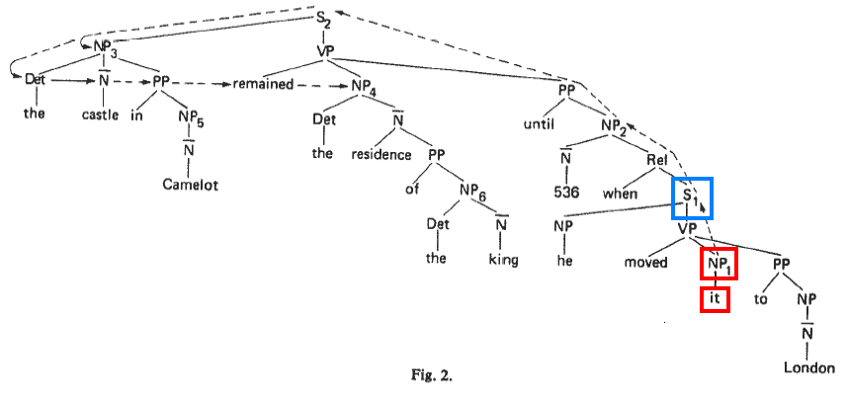
Example:
Go up tree to first NP or S encountered. Call node X, and path to it, p. Search left-to-right below X and to left of p, proposing any NP node which has an NP or S between it and X.

Slide 29
Example:
S1: search yields no candidate. Go to next step of the algorithm.

Slide 30
Hobbs’s “Naïve” Algorithm
1. Begin at the NP immediately dominating the pronoun.
2. Go up tree to first NP or S encountered.
  Call node X, and path to it, p.
  Search left-to-right below X and to left of p, proposing any NP node which has an NP or S between it and X.
3. If X is highest S node in sentence,
  Search previous trees, in order of recency, left-to-right, breadth-first, proposing NPs encountered.
4. Otherwise, from X, go up to first NP or S node encountered,
  Call this X, and path to it p.
5. If X is an NP, and p does not pass through an N-bar that X immediately dominates, propose X.
6. Search below X, to left of p, left-to-right, breadth-first, proposing NP encountered.
7. If X is an S, search below X to right of p, left-to-right, breadth-first, but not going through any NP or S, proposing NP encountered.
8. Go to 2.

Slide 31
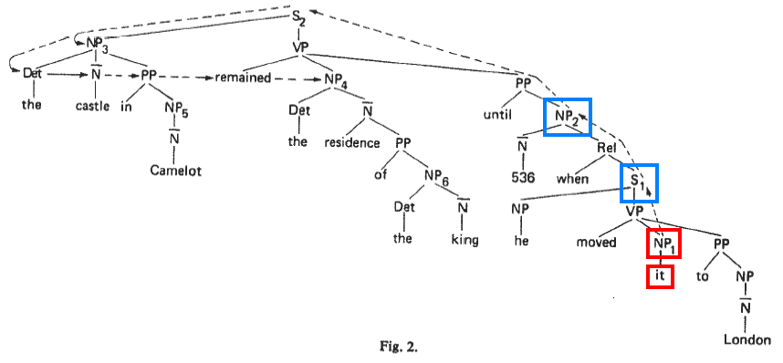
Example:
From X, go up to first NP or S node encountered. Call this X, and path to it p.

Slide 32
Hobbs’s “Naïve” Algorithm
1. Begin at the NP immediately dominating the pronoun.
2. Go up tree to first NP or S encountered.
  Call node X, and path to it, p.
  Search left-to-right below X and to left of p, proposing any NP node which has an NP or S between it and X.
3. If X is highest S node in sentence,
  Search previous trees, in order of recency, left-to-right, breadth-first, proposing NPs encountered.
4. Otherwise, from X, go up to first NP or S node encountered,
  Call this X, and path to it p.
5. If X is an NP, and p does not pass through an N-bar that X immediately dominates, propose X.
6. Search below X, to left of p, left-to-right, breadth-first, proposing NP encountered.
7. If X is an S, search below X to right of p, left-to-right, breadth-first, but not going through any NP or S, proposing NP encountered.
8. Go to 2.

Slide 33
Example:
NP2 is proposed. Rejected by selectional restrictions (dates can’t move).

Slide 34
Hobbs’s “Naïve” Algorithm
1. Begin at the NP immediately dominating the pronoun.
2. Go up tree to first NP or S encountered.
  Call node X, and path to it, p.
  Search left-to-right below X and to left of p, proposing any NP node which has an NP or S between it and X.
3. If X is highest S node in sentence,
  Search previous trees, in order of recency, left-to-right, breadth-first, proposing NPs encountered.
4. Otherwise, from X, go up to first NP or S node encountered,
  Call this X, and path to it p.
5. If X is an NP, and p does not pass through an N-bar that X immediately dominates, propose X.
6. Search below X, to left of p, left-to-right, breadth-first, proposing NP encountered.
7. If X is an S, search below X to right of p, left-to-right, breadth-first, but not going through any NP or S, proposing NP encountered.
8. Go to 2.

Slide 35
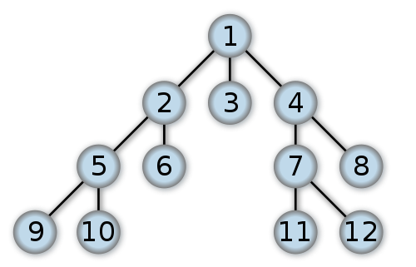
Left-to-right, breadth-first search

Slide 36
Example:
NP2: search yields no candidate. Go to next step of the algorithm.

Slide 37
Hobbs’s “Naïve” Algorithm
1. Begin at the NP immediately dominating the pronoun.
2. Go up tree to first NP or S encountered.
  Call node X, and path to it, p.
  Search left-to-right below X and to left of p, proposing any NP node which has an NP or S between it and X.
3. If X is highest S node in sentence,
  Search previous trees, in order of recency, left-to-right, breadth-first, proposing NPs encountered.
4. Otherwise, from X, go up to first NP or S node encountered,
  Call this X, and path to it p.
5. If X is an NP, and p does not pass through an N-bar that X immediately dominates, propose X.
6. Search below X, to left of p, left-to-right, breadth-first, proposing NP encountered.
7. If X is an S, search below X to right of p, left-to-right, breadth-first, but not going through any NP or S, proposing NP encountered.
8. Go to 2.

Slide 38
Hobbs’s “Naïve” Algorithm
1. Begin at the NP immediately dominating the pronoun.
2. Go up tree to first NP or S encountered.
  Call node X, and path to it, p.
  Search left-to-right below X and to left of p, proposing any NP node which has an NP or S between it and X.
3. If X is highest S node in sentence,
  Search previous trees, in order of recency, left-to-right, breadth-first, proposing NPs encountered.
4. Otherwise, from X, go up to first NP or S node encountered,
  Call this X, and path to it p.
5. If X is an NP, and p does not pass through an N-bar that X immediately dominates, propose X.
6. Search below X, to left of p, left-to-right, breadth-first, proposing NP encountered.
7. If X is an S, search below X to right of p, left-to-right, breadth-first, but not going through any NP or S, proposing NP encountered.
8. Go to 2.

Slide 39
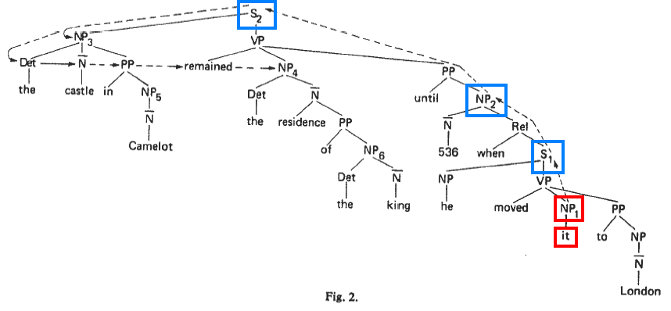
Example:
Search left-to-right below X and to left of p, proposing any NP node which has an NP or S between it and X.

Slide 40
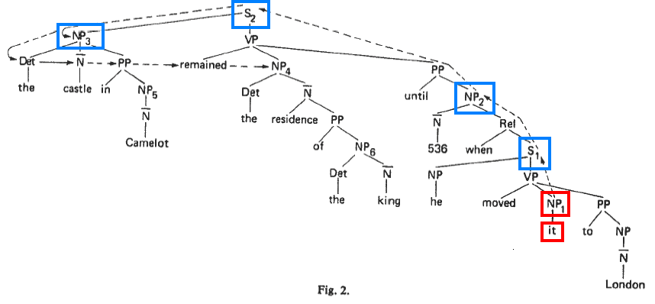
Example:
NP3: proposed. Rejected by rejected by selectional restrictions (can’t move large fixed objects.)

Slide 41
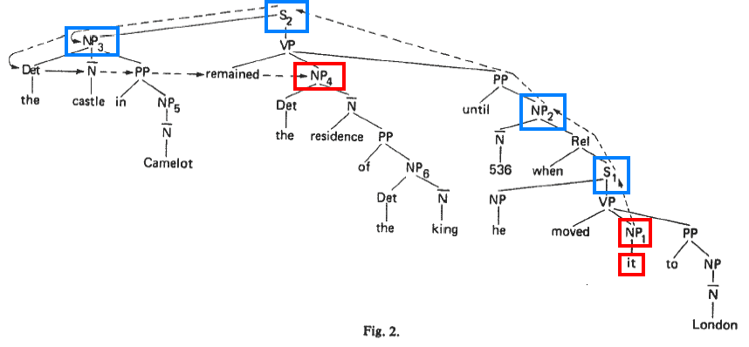
Example:
NP4: proposed. Accepted.

Slide 42
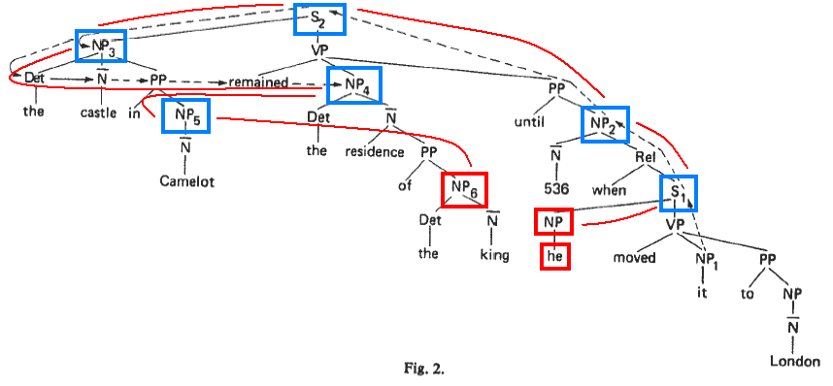
Another example:
The referent for “he”: we follow the same path, get to the same place, but reject NP4, then reject NP5. Finally, accept NP6.

Slide 43
The algorithm: evaluation
Corpus:
  Early civilization in China (book, non-fiction)
  Wheels (book, fiction)
  Newsweek (magazine, non-fiction)

Slide 44
The algorithm: evaluation
Hobbs analyzed, by hand, 100 consecutive examples from these three “very different” texts.
  pronouns resolved: “he”, “she”, “it”, “they”
  didn’t count “it” if it referred to a syntactically recoverable “that” clause – since, as he points out, the algorithm does just the wrong thing here.
Assumed “the correct parse” was available.

Slide 45
The algorithm: results
Overall, no selectional constraints: 88.3%
Overall, with selectional constraints: 91.7%

Slide 46
The algorithm: results
This is somewhat deceptive since in over half the cases there was only one nearby plausible antecedent. (p. 344)
132/300 times, there was a conflict
12/132 resolved by selectional constraints, 96/120 by algorithm

Slide 47
The algorithm: results
Thus, 81.8% of the conflicts were resolved by a combination of the algorithm and selection.
Without selectional restrictions, the algorithm was correct 72.7%.
Hobbs concludes that the naïve approach provides a high baseline.
Semantic algorithms will be necessary for much of the rest, but will not perform better for some time.

Slide 48
Adaptation for shallow parse (Kehler et al. 2004)
Andrew Kehler, Douglas Appelt, Lara Taylor, and Aleksandr Simma. 2004. Competitive Self-Trained Pronoun Interpretation. In Proceedings of NAACL 2004, 33-36.
Shallow parse: lowest-level constituents only.
for co-reference, we look at “base NPs”, i.e., noun and all modifiers to the left.
  a good student of linguistics with long hair
  The castle in Camelot remained the residence of the king until 536 when he moved it to London.

Slide 49
Adaptation for shallow parse
…noun groups are searched in the following order:
In current sentence, R->L, starting from L of PRO
In previous sentence, L->R
In S-2, L->R
In current sentence, L->R, starting from R of PRO
(Kehler et al. 2004)

Slide 50
Adaptation for shallow parse
In current sentence, R->L, starting from L of PRO
  he: no AGR
  536: dates can’t move
  the king: no AGR
  the residence: OK!
  The castle in Camelot remained the residence of the king until 536 when he moved it to London.

Slide 51
Another Approach: Using an
Explicit Discourse Model
Shalom Lappin and Herbert J. Leass. 1994. An algorithm for pronominal anaphora resolution. Computational Linguistics, 20(4):535–561.

Slide 52
Lappin and Leass 1994
Idea: Maintain a discourse model , in which there are representations for potential referents. (much like the DRSs we built throughout the quarter )
Lappin and Leass 1994 propose a discourse model in which potential referents have degrees of salience.
They try to resolve (pronoun) references by finding highly salient referents compatible with pronoun agreement features.
In effect, they incorporate:
  recency
  syntax-based preferences
  agreement, but no (other) semantics

Slide 53
Lappin and Leass 1994
First, we assign a number of salience factors & salience values to each referring expression.
The salience values (weights) are arrived by experimentation on a certain corpus.

Slide 54
Lappin and Leass 1994
Salience Factor | Salience Value
Sentence recency | 100
Subject emphasis | 80
Existential emphasis | 70
Accusative emphasis | 50
Indirect object emphasis | 40
Non-adverbial emphasis | 50
Head noun emphasis | 80

Slide 55
Lappin and Leass 1994
Non-adverbial emphasis is to penalize “demarcated adverbial PPs” (e.g., “In his hand, …”) by giving points to all other types.
Head noun emphasis is to penalize embedded referents.
Other factors & values:
  Grammatical role parallelism: 35
  Cataphora: -175

Slide 56
Lappin and Leass 1994
The algorithm employs a simple weighting scheme that integrates the effects of several preferences:
  For each new entity, a representation for it is added to the discourse model and salience value computed for it.
  Salience value is computed as the sum of the weights assigned by a set of salience factors.
    The weight a salience factor assigns to a referent is the highest one the factor assigns to the referent’s referring expression.
  Salience values are cut in half each time a new sentence is processed.

Slide 57
Lappin and Leass 1994
The steps taken to resolve a pronoun are as follows:
  Collect potential referents (four sentences back);
  Remove potential referents that don’t semantically agree;
  Remove potential referents that don’t syntactically agree;
  Compute salience values for the rest potential referents;
  Select the referent with the highest salience value.

Slide 58
Lappin and Leass 1994
Salience factors apply per NP, i.e., referring expression.
However, we want the salience for a potential referent.
  So, all NPs determined to have the same referent are examined.
The referent is given the sum of the highest salience factor associated with any such referring expression.
Salience factors are considered to have scope over a sentence
  so references to the same entity over multiple sentences add up
  while multiple references within the same sentence don’t.

Slide 59
Example (from Jurafsky and Martin)
John saw a beautiful Acura Integra at the dealership.
He showed it to Bob.
He bought it.

Slide 60
Example
John saw a beautiful Acura Integra at the dealership.
Referent Phrases Value
John {John} ?
Integra {a beautiful Acura Integra} ?
dealership {the dealership} ?

Slide 61
John
Salience Factor | Salience Value
Sentence recency | 100
Subject emphasis | 80
Existential emphasis
Accusative emphasis
Indirect object emphasis
Non-adverbial emphasis | 50
Head noun emphasis | 80

Slide 62
Example
John saw a beautiful Acura Integra at the dealership.
Referent Phrases Value
John {John} 310
Integra {a beautiful Acura Integra} ?
dealership {the dealership} ?

Slide 63
Integra
Salience Factor | Salience Value
Sentence recency | 100
Subject emphasis
Existential emphasis
Accusative emphasis | 50
Indirect object emphasis
Non-adverbial emphasis | 50
Head noun emphasis | 80

Slide 64
Example
John saw a beautiful Acura Integra at the dealership.
Referent Phrases Value
John {John} 310
Integra {a beautiful Acura Integra} 280
dealership {the dealership} ?

Slide 65
dealership
Salience Factor | Salience Value
Sentence recency | 100
Subject emphasis
Existential emphasis
Accusative emphasis
Indirect object emphasis
Non-adverbial emphasis | 50
Head noun emphasis | 80

Slide 66
Example
John saw a beautiful Acura Integra at the dealership.
Referent Phrases Value
John {John} 310
Integra {a beautiful Acura Integra} 280
dealership {the dealership} 230

Slide 67
Example
He showed it to Bob.
Referent Phrases Value
John {John} 310/2
Integra {a beautiful Acura Integra} 280/2
dealership {the dealership} 230/2
Referent Phrases Value
John {John} 155
Integra {a beautiful Acura Integra} 140
dealership {the dealership} 115

Slide 68
He
Salience Factor | Salience Value
Sentence recency | 100
Subject emphasis | 80
Existential emphasis
Accusative emphasis
Indirect object emphasis
Non-adverbial emphasis | 50
Head noun emphasis | 80

Slide 69
Example
He showed it to Bob.
Referent Phrases Value
John {John, he₁} 465
Integra {a beautiful Acura Integra} 140
dealership {the dealership} 115

Slide 70
It
Salience Factor | Salience Value
Sentence recency | 100
Subject emphasis
Existential emphasis
Accusative emphasis | 50
Indirect object emphasis
Non-adverbial emphasis | 50
Head noun emphasis | 80

Slide 71
Example
He showed it to Bob.
Referent Phrases Value
John {John, he₁} 465
Integra {a beautiful Acura Integra} 140
dealership {the dealership} 115
Since “Integra” is more salient than “dealership” (140>115):
  “it” refers to “Integra”

Slide 72
Example
He showed it to Bob.
Referent Phrases Value
John {John, he₁} 465
Integra {a beautiful Acura Integra, it₁} 420
dealership {the dealership} 115

Slide 73
Bob
Salience Factor | Salience Value
Sentence recency | 100
Subject emphasis
Existential emphasis
Accusative emphasis
Indirect object emphasis | 40
Non-adverbial emphasis | 50
Head noun emphasis | 80

Slide 74
Example
He showed it to Bob.
Referent Phrases Value
John {John, he₁} 465
Integra {a beautiful Acura Integra, it₁} 420
Bob {Bob} 270
dealership {the dealership} 115

Slide 75
Example
He bought it.
Referent Phrases Value
John {John, he₁} 465/2
Integra {a beautiful Acura Integra, it₁} 420/2
Bob {Bob} 270/2
dealership {the dealership} 115/2
Referent Phrases Value
John {John, he₁} 232.5
Integra {a beautiful Acura Integra, it₁} 210
Bob {Bob} 135
dealership {the dealership} 57.5

Slide 76
He
Salience Factor | Salience Value
Sentence recency | 100
Subject emphasis | 80
Existential emphasis
Accusative emphasis
Indirect object emphasis
Non-adverbial emphasis | 50
Head noun emphasis | 80

Slide 77
Example
He bought it.
Referent Phrases Value
John {John, he₁} 232.5
Integra {a beautiful Acura Integra, it₁} 210
Bob {Bob} 135
dealership {the dealership} 57.5
Since “John” is more salient than “Bob” (232.5>135):
  “he” refers to “John”

Slide 78
Example
He bought it.
Referent Phrases Value
John {John, he₁,he₂} 542.5
Integra {a beautiful Acura Integra, it₁} 210
Bob {Bob} 135
dealership {the dealership} 57.5

Slide 79
It
Salience Factor | Salience Value
Sentence recency | 100
Subject emphasis
Existential emphasis
Accusative emphasis | 50
Indirect object emphasis
Non-adverbial emphasis | 50
Head noun emphasis | 80

Slide 80
Example
He bought it.
Referent Phrases Value
John {John, he₁,he₂} 542.5
Integra {a beautiful Acura Integra, it₁} 210
Bob {Bob} 135
dealership {the dealership} 57.5
Since “Integra” is more salient than “dealership” (210>57.5):
  “it” refers to “Integra”

Slide 81
Example
He bought it.
Referent Phrases Value
John {John, he₁,he₂} 542.5
Integra {a beautiful Acura Integra, it₁,it₂} 490
Bob {Bob} 135
dealership {the dealership} 57.5
We should have added 35 for grammatical role parallelism, but we ignore this.

Slide 82
Evaluation of Lappin and Leass 1994
Weights were arrived at by experimentation on a corpus of computer training manuals.
Combined with other filters, algorithm achieve 86% accuracy (74% / 89% inter- / intra-sentential):
  applied to unseen data of same genre
Hobbs’ algorithm applied to same data is 82% accurate (87% / 81% inter / intra).

Slide 83
Centering Theory
Grosz, Barbara J., Aravind Joshi, and Scott Weinstein. 1995. Centering: A framework for modeling the local coherence of discourse. Computational Linguistics, 21(2):203-225
Brennan, Susan E., Marilyn W. Friedman, and Carl J. Pollard. 1987. A centering approach to pronouns. In Proceedings of the 25th Annual Meeting of the Association for Computational Linguistics, pages 155-162.

Slide 84
Centering Theory
Basic ideas:
A discourse has a focus, or center.
The center typically remains the same for a few sentences, then shifts to a new object.
The center of a sentence is typically pronominalized.
Once a center is established, there is a strong tendency for subsequent pronouns to continue to refer to it.

Slide 85
Some examples
Compare the two discourses:
a. John went to his favorite music store to buy a piano.
b. He had frequented the store for many years.
c. He was excited that he could finally buy a piano.
d. He arrived just as the store was closing for the day.
a. John went to his favorite music store to buy a piano.
b. It was a store John had frequented for many years.
c. He was excited that he could finally buy a piano.
d. It was closing just as John arrived.
Notes:
Continuity versus focus switching.
The first discourse centers around a single individual and is slightly more coherent than the second discourse which flips back and forth between entities that are the center of attention.

Slide 86
Another example
a. Terry really goofs sometimes.
b. Yesterday was a beautiful day and he was excited about trying out his new sailboat.
c. He wanted Tony to join him on a sailing expedition.
d. He called him at 6 AM.
e. He was sick and furious at being woken up so early.
Notes:
By using a pronoun to refer to Tony in utterance (e) the speaker may confuse the hearer and cause him to backtrack once he gets to the phrase woken up.
This is because until that point, Terry was the focus of attention.

Slide 87
Replace pronoun with proper name
a. Terry really goofs sometimes.
b. Yesterday was a beautiful day and he was excited about trying out his new sailboat.
c. He wanted Tony to join him on a sailing expedition.
d. He called him at 6 AM.
e. Tony was sick and furious at being woken up so early.
Notes:
By changing he to Tony in utterance (e), the discourse becomes more natural. However, the same problem arises in utterance (g) because by utterance (f) the center of attention has shifted from Terry to Tony and the use of a pronoun to refer to Terry at that point is confusing.

Slide 88
We continue the story …
a. Terry really goofs sometimes.
b. Yesterday was a beautiful day and he was excited about trying out his new sailboat.
c. He wanted Tony to join him on a sailing expedition.
d. He called him at 6 AM.
e. Tony was sick and furious at being woken up so early.
f. He told Terry to get lost and hung up.
g. Of course, he hadn’t intended to upset Tony.
Notes:
By changing he to Tony in utterance (e), the discourse becomes more natural. However, the same problem arises in utterance (g) because by utterance (f) the center of attention has shifted from Terry to Tony and the use of a pronoun to refer to Terry at that point is confusing.

Slide 89
Once again, replace pronoun with proper name
a. Terry really goofs sometimes.
b. Yesterday was a beautiful day and he was excited about trying out his new sailboat.
c. He wanted Tony to join him on a sailing expedition.
d. He called him at 6 AM.
e. Tony was sick and furious at being woken up so early.
f. He told Terry to get lost and hung up.
g. Of course, Terry hadn’t intended to upset Tony.
Notes:
Ah, Better !

Slide 90
Another example
Compare the two discourses
  1 a. John was very worried last night.
  b. He called Bob.
  c. He told him that there was a big problem.
  2 a. John was very worried last night.
  b. He called Bob.
  c. He told him never to call again at such a late hour.
Notes:
The second discourse segment is less coherent than the first.
When the hearer hears utterance 2c he starts by assuming that the pronoun refers to John.
Only after understanding the meaning of the utterance, does he backtrack and understand that the pronoun refers to Bob.

Slide 91
Again, replace pronoun with proper name
Compare the two discourses
  1 a. John was very worried last night.
  b. He called Bob.
  c. He told him that there was a big problem.
  2 a. John was very worried last night.
  b. He called Bob.
  c. Bob told him never to call again at such a late hour.
Notes:
The second discourse segment is less coherent than the first.
When the hearer hears utterance 2c he starts by assuming that the pronoun refers to John.
Only after understanding the meaning of the utterance, does he backtrack and understand that the pronoun refers to Bob.

Slide 92
When are pronouns better than proper names?
a. Susan gave Betsy a pet hamster.
b. She reminded her that such hamsters are quite shy.
Compare the following alternative utterances.
c1. She asked Betsy whether she liked the gift.
c2. Susan asked her whether she liked the gift.
c3. Betsy told her that she really liked the gift.
c4. She told Susan that she really liked the gift.
Notes:
Utterance c1 is better than c3 and c2 is better than c4.
By utterance b, Susan is the center of attention so it is more natural to use a pronoun for Susan and a proper name for Betsy.
This example shows the preferred use of pronoun versus proper name is not so much to do with the syntactic role (subject versus object) but rather with the center of attention.

Slide 93
Centering
Centering theory was developed by Barbara J. Grosz, Aravind K. Joshi and Scott Weinstein in the 1980s to explain this kind of phenomena.

Slide 94
Definitions
Utterance – A sentence in the context of a discourse.
Center – An entity referred to in the discourse (our discourse referents).
Forward looking centers – An utterance U_{n} is assigned a set of centers C_{f}(U_{n}) that are referred to in U_{n} (basically, the drefs introduced / acccessed in a sentence).
Backward looking center – An utterance U_{n} is assigned a single center C_{b}(U_{n}), which is equal to one of the centers in C_{f}(U_{n-1})∩C_{f}(U_{n}).
If there is no such center, C_{b}(U_{n}) is NIL.

Slide 95
Ranking of forward looking centers
C_{f}(U_{n}) is an ordered set.
Its order reflects the prominence of the centers in the utterance.
The ordering (ranking) is done primarily according to the syntactic position of the word in the utterance (subject > object(s) > other).
The prominent center of an utterance, C_{p}(U_{n}), is the highest ranking center in C_{f}(U_{n}).

Slide 96
Ranking of forward looking centers
Think of the backward looking center C_{b}(U_{n}) as the current topic.
Think of the preferred center C_{p}(U_{n}) as the potential new topic.

Slide 97
Constraints on centering
There is precisely one C_{b}.
Every element of C_{f}(U_{n}) must be realized in U_{n}.
C_{b}(U_{n}) is the highest-ranked element of C_{f}(U_{n-1}) that is realized in U_{n}.

Slide 98
Another example
U₁. John drives a Ferrari.
U₂. He drives too fast.
U₃. Mike races him often.
U₄. He sometimes beats him.

Slide 99
Let’s see what the centers are…
U₁. John drives a Ferrari.
C_{b}(U₁) = NIL (or: John). C_{f}(U₁) = (John, Ferrari)
U₂. He drives too fast.
C_{b}(U₂) = John. C_{f}(U₂) = (John)
U₃. Mike races him often.
C_{b}(U₃) = John. C_{f}(U₃) = (Mike, John)
U₄. He sometimes beats him.
C_{b}(U₄) = Mike. C_{f}(U₄) = (Mike, John)
Notes:
Lets assume that John has been the center of attention before utterance U₁ and hence C_{b}(U₁) = John.
Actually, a Ferrari is an indefinite NP and is treated differently, but I will not go into that here.

Slide 100
Types of transitions
Transition Type from U_{n-1} to U_{n} | C_{b}(U_{n}) = C_{b}(U_{n-1}) | C_{b}(U_{n}) = C_{p}(U_{n})
Center Continuation | + | +
Center Retaining | + | -
Center Shifting-1 | - | +
Center Shifting | - | -

Slide 101
Let’s see what the transitions are…
U₁. John drives a Ferrari.
C_{b}(U₁) = John. C_{f}(U₁) = (John, Ferrari)
U₂. He drives too fast.
C_{b}(U₂) = John. C_{f}(U₂) = (John)

Slide 102
Types of transitions
Transition Type from U_{n-1} to U_{n} | C_{b}(U_{n}) = C_{b}(U_{n-1}) | C_{b}(U_{n}) = C_{p}(U_{n})
Center Continuation | + | +
Center Retaining | + | -
Center Shifting-1 | - | +
Center Shifting | - | -

Slide 103
Let’s see what the transitions are…
U₁. John drives a Ferrari.
C_{b}(U₁) = John. C_{f}(U₁) = (John, Ferrari)
U₂. He drives too fast. (continuation)
C_{b}(U₂) = John. C_{f}(U₂) = (John)

Slide 104
Let’s see what the transitions are…
U₁. John drives a Ferrari.
C_{b}(U₁) = John. C_{f}(U₁) = (John, Ferrari)
U₂. He drives too fast. (continuation)
C_{b}(U₂) = John. C_{f}(U₂) = (John)
U₃. Mike races him often.
C_{b}(U₃) = John. C_{f}(U₃) = (Mike, John)

Slide 105
Types of transitions
Transition Type from U_{n-1} to U_{n} | C_{b}(U_{n}) = C_{b}(U_{n-1}) | C_{b}(U_{n}) = C_{p}(U_{n})
Center Continuation | + | +
Center Retaining | + | -
Center Shifting-1 | - | +
Center Shifting | - | -

Slide 106
Let’s see what the transitions are…
U₁. John drives a Ferrari.
C_{b}(U₁) = John. C_{f}(U₁) = (John, Ferrari)
U₂. He drives too fast. (continuation)
C_{b}(U₂) = John. C_{f}(U₂) = (John)
U₃. Mike races him often. (retaining)
C_{b}(U₃) = John. C_{f}(U₃) = (Mike, John)

Slide 107
Let’s see what the transitions are…
U₁. John drives a Ferrari.
C_{b}(U₁) = John. C_{f}(U₁) = (John, Ferrari)
U₂. He drives too fast. (continuation)
C_{b}(U₂) = John. C_{f}(U₂) = (John)
U₃. Mike races him often. (retaining)
C_{b}(U₃) = John. C_{f}(U₃) = (Mike, John)
U₄. He sometimes beats him.
C_{b}(U₄) = Mike. C_{f}(U₄) = (Mike, John)

Slide 108
Types of transitions
Transition Type from U_{n-1} to U_{n} | C_{b}(U_{n}) = C_{b}(U_{n-1}) | C_{b}(U_{n}) = C_{p}(U_{n})
Center Continuation | + | +
Center Retaining | + | -
Center Shifting-1 | - | +
Center Shifting | - | -

Slide 109
Let’s see what the transitions are…
U₁. John drives a Ferrari.
C_{b}(U₁) = John. C_{f}(U₁) = (John, Ferrari)
U₂. He drives too fast. (continuation)
C_{b}(U₂) = John. C_{f}(U₂) = (John)
U₃. Mike races him often. (retaining)
C_{b}(U₃) = John. C_{f}(U₃) = (Mike, John)
U₄. He sometimes beats him. (shifting-1)
C_{b}(U₄) = Mike. C_{f}(U₄) = (Mike, John)

Slide 110
Centering rules in discourse
If some element of C_{f}(U_{n-1}) is realized as a pronoun in U_{n}, then so is C_{b}(U_{n}).
Continuation is preferred over retaining, which is preferred over shifting-1, which is preferred over shifting:
Cont >> Retain >> Shift-1 >> Shift

Slide 111
Violation of rule 1
Assuming He in utterance U₁ refers to John…
U₁. He has been acting quite odd.
U₂. He called up Mike Yesterday.
U₃. John wanted to meet him urgently.

Slide 112
In more detail …
U₁. He has been acting quite odd.
C_{b}(U₁) = John. C_{f}(U₁) = (John)
U₂. He called up Mike Yesterday.
C_{b}(U₂) = John. C_{f}(U₂) = (John, Mike)
U₃. John wanted to meet him urgently.
C_{b}(U₃) = John. C_{f}(U₃) = (John, Mike)
Notes:
Utterance U₃ violates Rule 1 because some element of U₂ is realized as a pronoun in U₃ (namely Mike) and C_{b}(U₃) (John) is realized in U₃ as a proper name.

Slide 113
Violation of rule 2
Compare the two discourses we started with:
U₁. John went to his favorite music store to buy a piano.
U₂. He had frequented the store for many years.
U₃. He was excited that he could finally buy a piano.
U₄. He arrived just as the store was closing for the day.
U₁. John went to his favorite music store to buy a piano.
U₂. It was a store John had frequented for many years.
U₃. He was excited that he could finally buy a piano.
U₄. It was closing just as John arrived.
Notes:
Continuity versus focus switching.
The first discourse centers around a single individual and is slightly more coherent than the second discourse which flips back and forth between entities that are the center of attention.

Slide 114
Transitions for the 1st discourse
U₁. John went to his favorite music store to buy a piano.
C_{b}(U₁) = John. C_{f}(U₁) = (John, store, piano).
U₂. He had frequented the store for many years.
C_{b}(U₂) = John. C_{f}(U₂) = (John, store). CONT
U₃. He was excited that he could finally buy a piano.
C_{b}(U₃) = John. C_{f}(U₃) = (John, piano). CONT
U₄. He arrived just as the store was closing for the day.
C_{b}(U₄) = John. C_{f}(U₄) = (John, store). CONT

Slide 115
Transitions for the 2nd discourse
U₁. John went to his favorite music store to buy a piano. C_{b}(U₁) = John. C_{f}(U₁) = (John, store, piano).
U₂. It was a store John had frequented for many years.
C_{b}(U₂) = John. C_{f}(U₂) = (store, John). RETAIN
U₃. He was excited that he could finally buy a piano.
C_{b}(U₃) = John. C_{f}(U₃) = (John, piano). CONT
U₄. It was closing just as John arrived.
C_{b}(U₄) = John. C_{f}(U₄) = (store, John). RETAIN
Notes:
The switching between continuation and retaining in this example reduces the coherency of the discourse.

Slide 116
The example we used for Lappin & Leass 1994
U₁: John saw a beautiful Acura Integra at the dealership.
C_{b}(U₁) = John / NIL. C_{f}(U₁) = (John, Integra, dealership).
U₂: He showed it to Bob.
C_{b}(U₂) = John. C_{f}(U₂) = (John, Integra, Bob) CONT
But: C_{b}(U₂) = John. C_{f}(U₂) = (John, dealership, Bob) CONT
U₃: He bought it.
C_{b}(U₃) = John. C_{f}(U₃) = (John, Integra) CONT √
C_{b}(U₃) = Integra. C_{f}(U₃) = (Bob, Integra) SHIFT

Slide 117
Centering algorithm
An algorithm for centering and pronoun binding has been presented by Susan E. Brennan, Marilyn W. Friedman and Carl J. Pollard, based on the centering theory we have just discussed.

Slide 118
General structure of algorithm
For each utterance perform the following steps
Anchor construction:
Create all possible anchors (pairs of forward centers and a backward center).
Anchor filtering:
Filter out the bad anchors according to various filters.
Anchor ranking:
Rank the remaining anchors according to their transition type.

Slide 119
General structure of algorithm
This is very similar to the general architecture of the algorithm in Lappin & Leass 1994:
First: filtering based on hard constraints
Then: ranking based on some soft constraints

Slide 120
Construction of the anchors
Create a list of referring expressions (REs) in the utterance, ordered by grammatical relation.
Expand each RE into a center according to whether it is a pronoun or a proper name. In case of pronouns, the agreement features must match.
Create a set of backward centers according to the forward centers of the previous utterance, plus NIL.
Create a set of anchors, which is the Cartesian product of the possible backward and forward centers.

Slide 121
Filtering the proposed anchors
The constructed anchors undergo the following filters.
Remove all anchors that assign the same center to two syntactic positions that cannot co-index (binding theory).
Remove all anchors which violate constraint 3, i.e. whose C_{b} is not the highest ranking center of the previous C_{f} which appears in the anchor’s C_{f} list.
Remove all anchors which violate rule 1. If the utterance has pronouns then remove all anchors where the C_{b} is not realized by a pronoun.

Slide 122
Ranking the anchors
Classify, every anchor that passed the filters, into its transition type (cont, retain, shift-1, shift).
Choose the anchor with the most preferable transition type according to rule 2.

Slide 123
Let’s look at an example
U₁. John likes to drive fast.
C_{b}(U₁) = John. C_{f}(U₁) = (John)
U₂. He races Mike.
C_{b}(U₂) = John. C_{f}(U₂) = (John, Mike)
U₃. Mike beats him sometimes.
Let’s generate the anchors for U_{3.}

Slide 124
Anchor construction for U₃
C_{b}(U₂) = John. C_{f}(U₂) = (John, Mike)
U₃. Mike beats him sometimes.
Create a list of REs.
REs in U₃
Mike
him

Slide 125
Anchor construction for U₃
C_{b}(U₂) = John. C_{f}(U₂) = (John, Mike)
U₃. Mike beats him sometimes.
Create a list of REs.
Expand into possible forward center lists.
Potential C_{f}s
REs in U₃
Mike
John
Mike
him
Mike
Mike

Slide 126
Anchor construction for U₃
C_{b}(U₂) = John. C_{f}(U₂) = (John, Mike)
U₃. Mike beats him sometimes.
Create a list of REs.
Expand into possible forward center lists.
Create possible backward centers according to C_{f}(U₂).
Potential C_{b}s
Potential C_{f}s
REs in U₃
John
Mike
John
Mike
Mike
him
Mike
Mike
NIL

Slide 127
Anchor construction for U₃
C_{b}(U₂) = John. C_{f}(U₂) = (John, Mike)
U₃. Mike beats him sometimes.
Create a list of REs.
Expand into possible forward center lists.
Create possible backward centers according to C_{f}(U₂).
Create a list of all anchors (cartesian product).
Potential C_{b}s
Potential C_{f}s
REs in U₃
John
Mike
John
Mike
Mike
him
Mike
Mike
NIL

Slide 128
Anchor construction for U₃
C_{b}(U₂) = John. C_{f}(U₂) = (John, Mike)
U₃. Mike beats him sometimes.
Create a list of REs.
Expand into possible forward center lists.
Create possible backward centers according to C_{f}(U₂).
Create a list of all anchors (cartesian product).
C_{b}
_{Mike}
_{him}
John
John
Mike
Mike
NIL
NIL
Mike
Mike
Mike
Mike
Mike
Mike
John
Mike
John
Mike
John
Mike

Slide 129
Filtering the anchors
C_{b}(U₂) = John. C_{f}(U₂) = (John, Mike)
U₃. Mike beats him sometimes.
Remove all anchors that assign the same center to two syntactic positions that cannot co-index.
C_{b}
_{Mike}
_{him}
John
John
Mike
Mike
NIL
NIL
Mike
Mike
Mike
Mike
Mike
Mike
John
Mike
John
Mike
John
Mike

Slide 130
Filtering the anchors
C_{b}(U₂) = John. C_{f}(U₂) = (John, Mike)
U₃. Mike beats him sometimes.
Remove all anchors that assign the same center to two syntactic positions that cannot co-index.
Remove all anchors which violate constraint 3, i.e. whose C_{b} is not the highest ranking center in C_{f}(U₂) which appears in the anchor’s C_{f}.
C_{b}
_{Mike}
_{him}
John
John
Mike
Mike
NIL
NIL
Mike
Mike
Mike
Mike
Mike
Mike
John
Mike
John
Mike
John
Mike

Slide 131
Filtering the anchors
C_{b}(U₂) = John. C_{f}(U₂) = (John, Mike)
U₃. Mike beats him sometimes.
Remove all anchors that assign the same center to two syntactic positions that cannot co-index.
Remove all anchors which violate constraint 3, i.e. whose C_{b} is not the highest ranking center in C_{f}(U₂) which appears in the anchor’s C_{f}.
Remove all anchors which violate rule 1, i.e. the C_{b} must be realized by a pronoun.
C_{b}
_{Mike}
_{him}
John
John
Mike
Mike
NIL
NIL
Mike
Mike
Mike
Mike
Mike
Mike
John
Mike
John
Mike
John
Mike

Slide 132
Ranking the anchors
C_{b}(U₂) = John. C_{f}(U₂) = (John, Mike)
The only remaining anchor –
C_{b}(U₃) = John. C_{f}(U₃) = (Mike, John)
RETAIN

Slide 133
Evaluation
The algorithm waits until the end of a sentence to resolve references, whereas humans appear to do this on-line.

Slide 134
Evaluation (example from Kehler)
a. Terry really gets angry sometimes.
b. Yesterday was a beautiful day and he was excited about trying out his new sailboat.
c. He wanted Tony to join him on a sailing expedition, and left him a message on his answering machine. [C_{b}=C_{p}=Terry]
d. Tony called him at 6AM the next morning. [C_{b}=Terry, C_{p}=Tony]
e1. He was furious for being woken up so early.
e2. He was furious with him for being woken up so early.
e3. He was furious with Tony for being woken up so early.

Slide 135
Evaluation (example from Kehler)
[C_{b}=Terry, C_{p}=Tony]
e1. He was furious for being woken up so early.
e2. He was furious with him for being woken up so early.
e3. He was furious with Tony for being woken up so early.
BFP algorithm picks:
– Terry for e1 (preferring CONT over SHIFT-1)
– Tony for e2 (preferring SHIFT-1 over SHIFT)
– ?? for e3, as this violates Constraint 1, but would be a SHIFT otherwise

Slide 136
Evaluation (example from Kehler)
Reference seems to be influenced by the rhetorical relations between sentences, which BFP is not sensitive to.

Slide 137
Centering vs Hobbs
Marilyn A. Walker. 1989, Evaluating discourse processing algorithms. In Proceedings of ACL 27, Vancouver, British Columbia, 251-261.
Walker 1989 manually compared a version of centering to Hobbs on 281 examples from three genres of text.
Reported 81.8% for Hobbs, 77.6% centering.

Slide 138
Corpus-based Evaluation of Centering
Massimo Poesio, Rosemary Stevenson, Barbara Di Eugenio, Janet Hitzeman. 2004. Centering: A Parametric Theory and Its Instantiations. Computational Linguistics 30:3, 309 – 363

Slide 139
Comparison
“A long-standing weakness in the area of anaphora resolution: the inability to fairly and consistently compare anaphora resolution algorithms due not only to the difference of evaluation data used, but also to the diversity of pre-processing tools employed by each system.” (Barbu & Mitkov, 2001)
It’s customary to evaluate algorithms on the MUC-6 and MUC-7 coreference corpora.
  http://www.cs.nyu.edu/cs/faculty/grishman/muc6.html
  http://www.itl.nist.gov/iaui/894.02/related_projects/muc/proceedings/muc_7_toc.html
  http://www.aclweb.org/anthology-new/M/M98/M98-1029.pdf

